Slide 1
Rob Byrd
Enterprise Architecture Findings

Slide 2
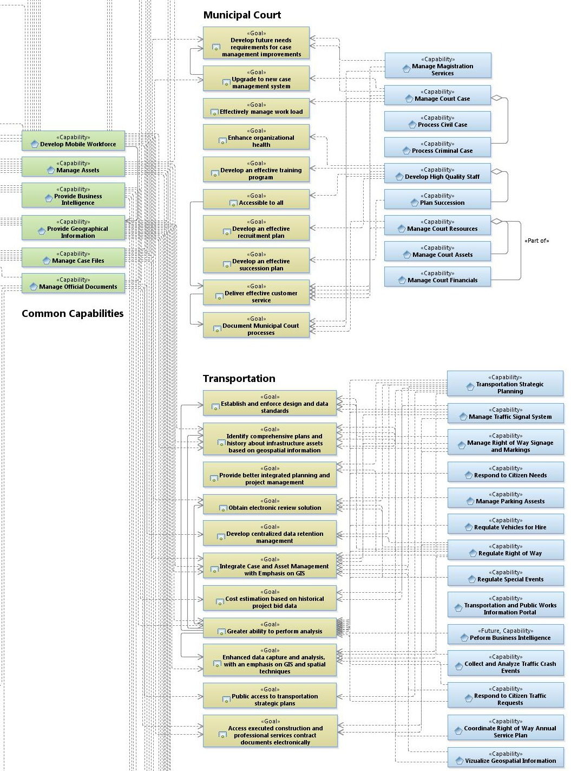
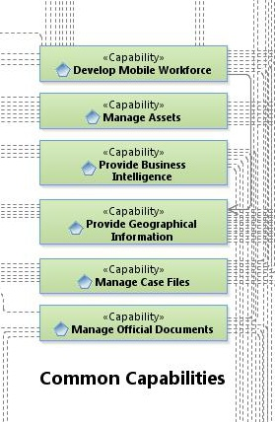
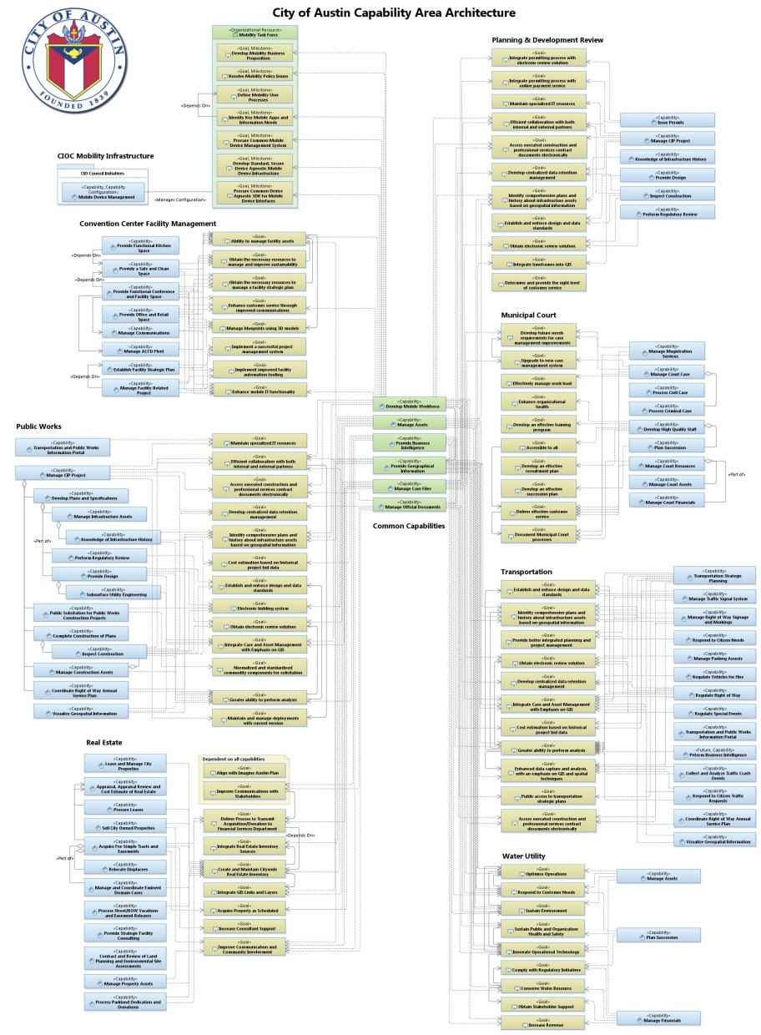
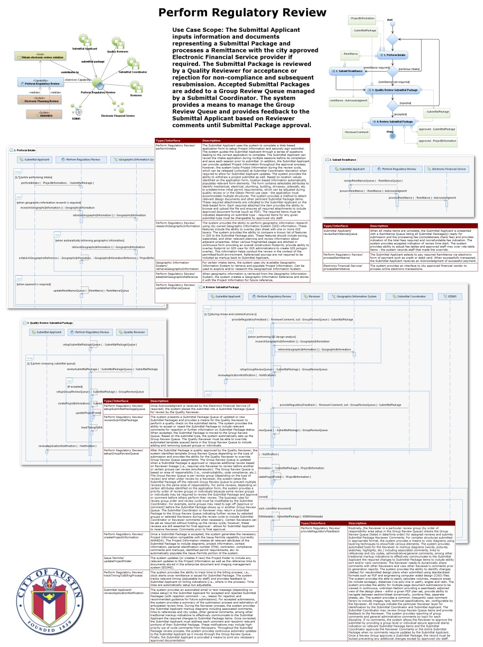
Aligning IT Services to Business Needs
Business Capabilities
Business Goals

Slide 3
Realize the Goal
Use Case Specification
Integrates the business need
Defines the user experience
Captures the business rules
A ‘contract’ with the stakeholder

Slide 4
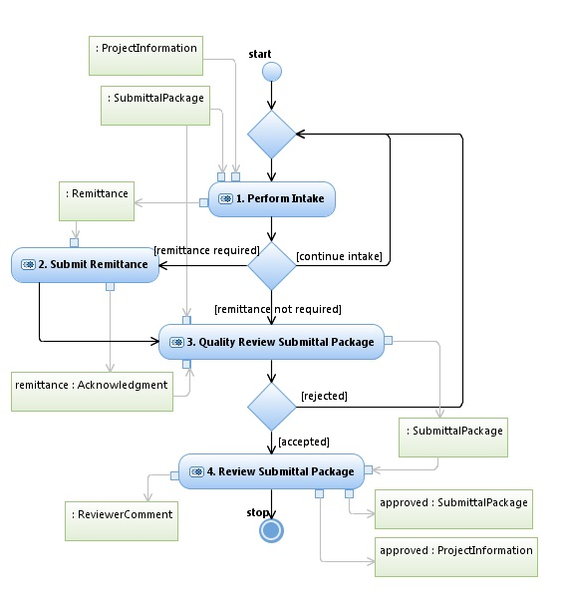
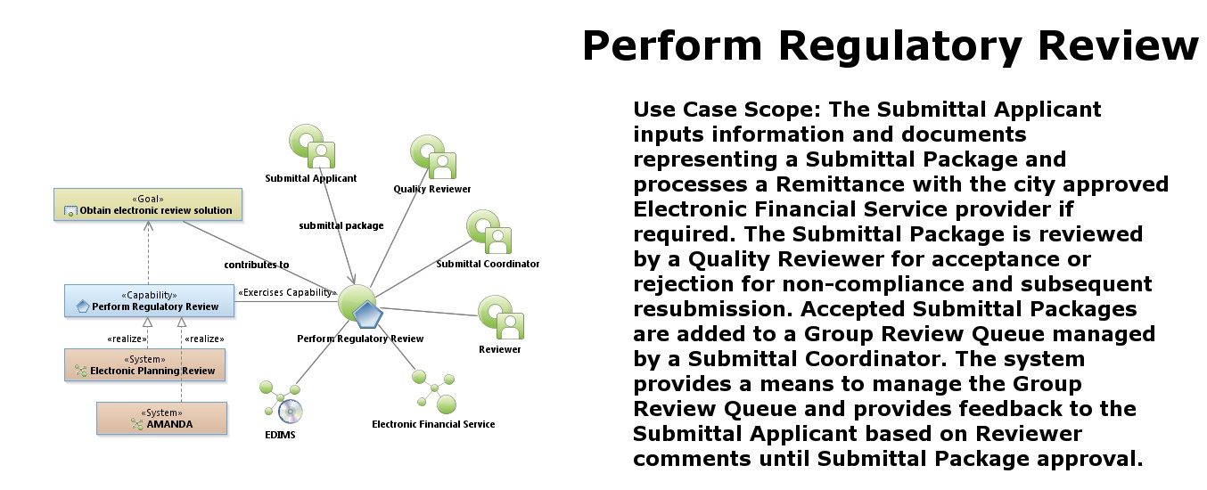
Goal Realization…
Documents Process…
Develops scope…

Slide 5
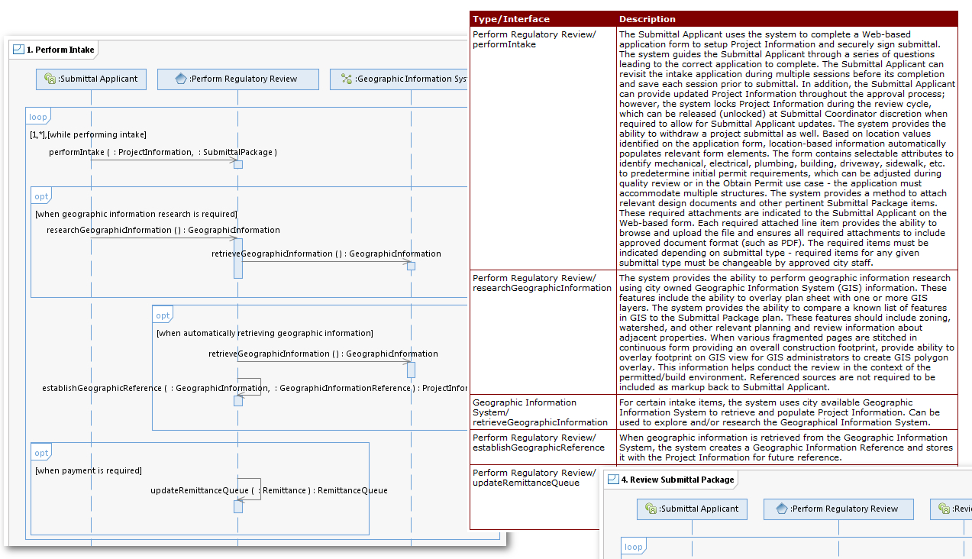
Define the User Experience
Integrates Business Need…

Slide 6
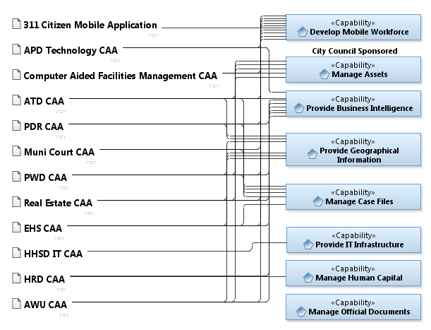
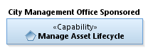
Relationship to Enterprise Strategies
part of
depends on

Slide 7
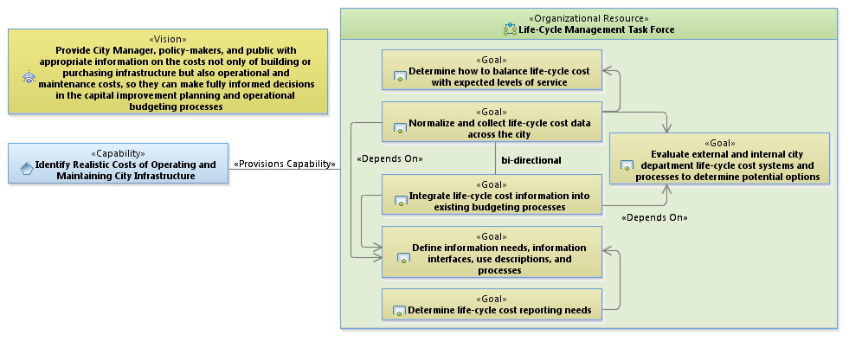
Capability Area Architecture

